Slide 1
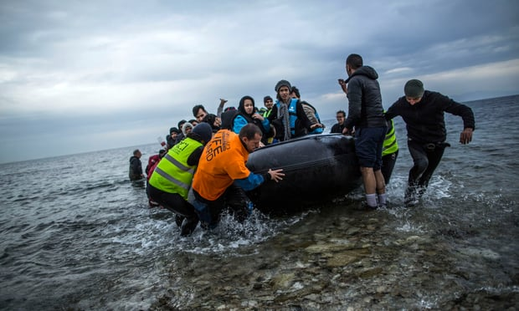
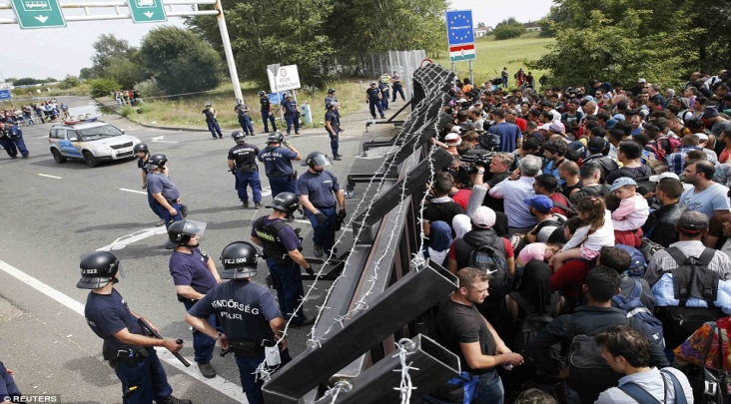
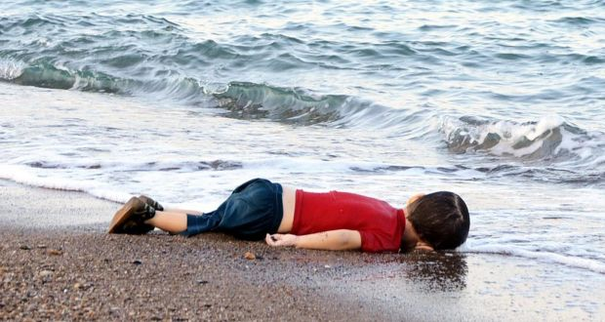
Refugee Crisis In Europe 2012-2016
WHERE IS HOME?

Slide 2
Challenges
Data variation (worldwide conflict)
Undocumented refugees vs. refugee applicants
(transit countries , accessibility, integration)
Time (worldwide statistics vs. Europe only)

Slide 3
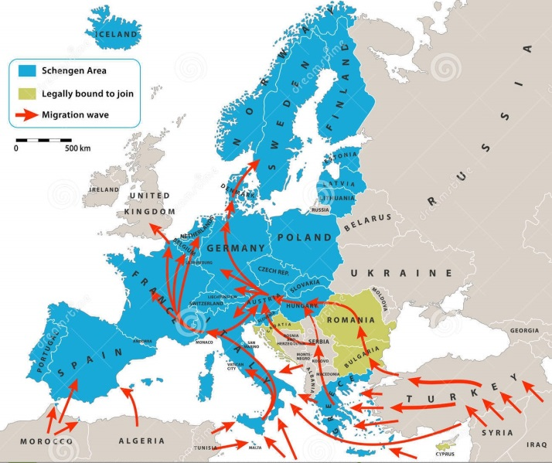
Origin vs. Destination

Slide 4
MAPS

Slide 5

Conclusion

Slide 6
WAR is BAD

Slide 7

Peace out Homies

